Slide 1
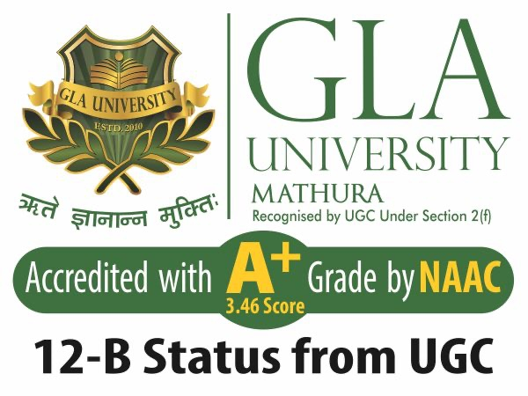

Agile Software Development
Topic: Agile Scrum Framework
Dr. Nikhil Govil
Associate Professor, Program Coordinator – B.Tech. (CSE), Dept. of CEA

Slide 2

Agile Frameworks
Some of the most popular Agile frameworks are:
Scrum
Kanban
Extreme Programming (XP)
Crystal
Lean
Feature Driven Development (FDD)
Dynamic System Development Methodology (DSDM)
Agile Project Management (APM)
OpenUp etc.

Slide 3

Scrum Introduction
Scrum is a framework for developing and sustaining complex products.
It is developed by Ken Schwaber and Jeff Sutherland.
The term is borrowed from Rugby.

Slide 4
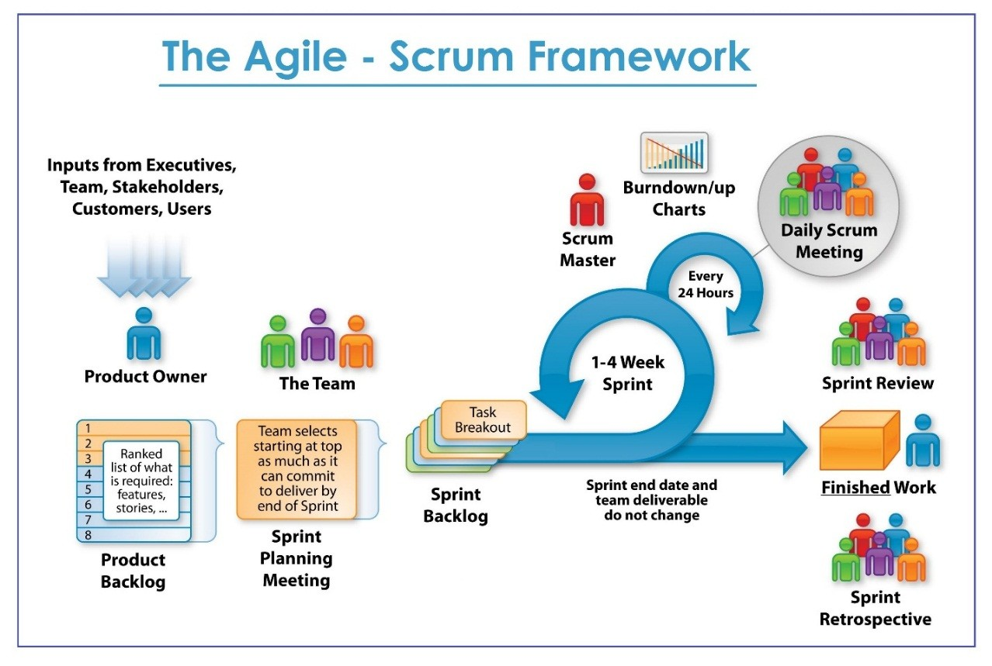
Agile – Scrum Framework

Slide 5
Scrum Introduction
Small cross-functional teams (5-9).
Task is completed in the form of iterations (Sprints).
Daily Scrum meeting organized.
Sprint review & sprint retrospective.

Slide 6
Scrum Practices
Product and release backlog
A list of the features to be implemented in the project and ordered by priority.
Can adjust over time as needed, based on feedback.
A product manager is responsible for maintaining.

Slide 7
Scrum Practices
Burn down Chart
Make best estimate of time to complete what is currently in the backlog.
Plot the time on a chart.
By studying chart, understand how team functions.
Ensure burn down to 0 at completion date.

Slide 8
Scrum Practices
Sprint
The sprint is a ~1 month period after which some product is delivered.
Features are assigned from the product backlog to a sprint backlog.
Plan meeting.
New functionality is produced by the end of the sprint.
After sprint, a review meeting is held to evaluate the sprint.

Slide 9
Scrum Practices
Scrum meeting
15 minute daily meeting.
All team members show up.
Quickly mention what they did since last Scrum, any obstacles encountered, and what they will do next.
Some team members are appointed to be the Scrum Master-in charge of Scrum meeting, and responsible for seeing that issues raised get addressed.
Customers, management officials are encouraged to observe.

Slide 10
References
Ken Schawber & Mike Beedle, Agile Software Development with Scrum, Pearson, 2008.
Robert C. Martin, Agile Software Development, Principles, Patterns and Practices, Prentice Hall, 2002.
Lisa Crispin & Janet Gregory, Agile Testing: A Practical Guide for Testers and Agile Teams, Addison Wesley, 2008.
Alistair Cockburn, Agile Software Development: The Cooperative Game, Addison Wesley, 2006.
https://www.scrum.org/resources/what-is-scrum/last accessed on 11 August 2024.

Slide 11


